Slide 1
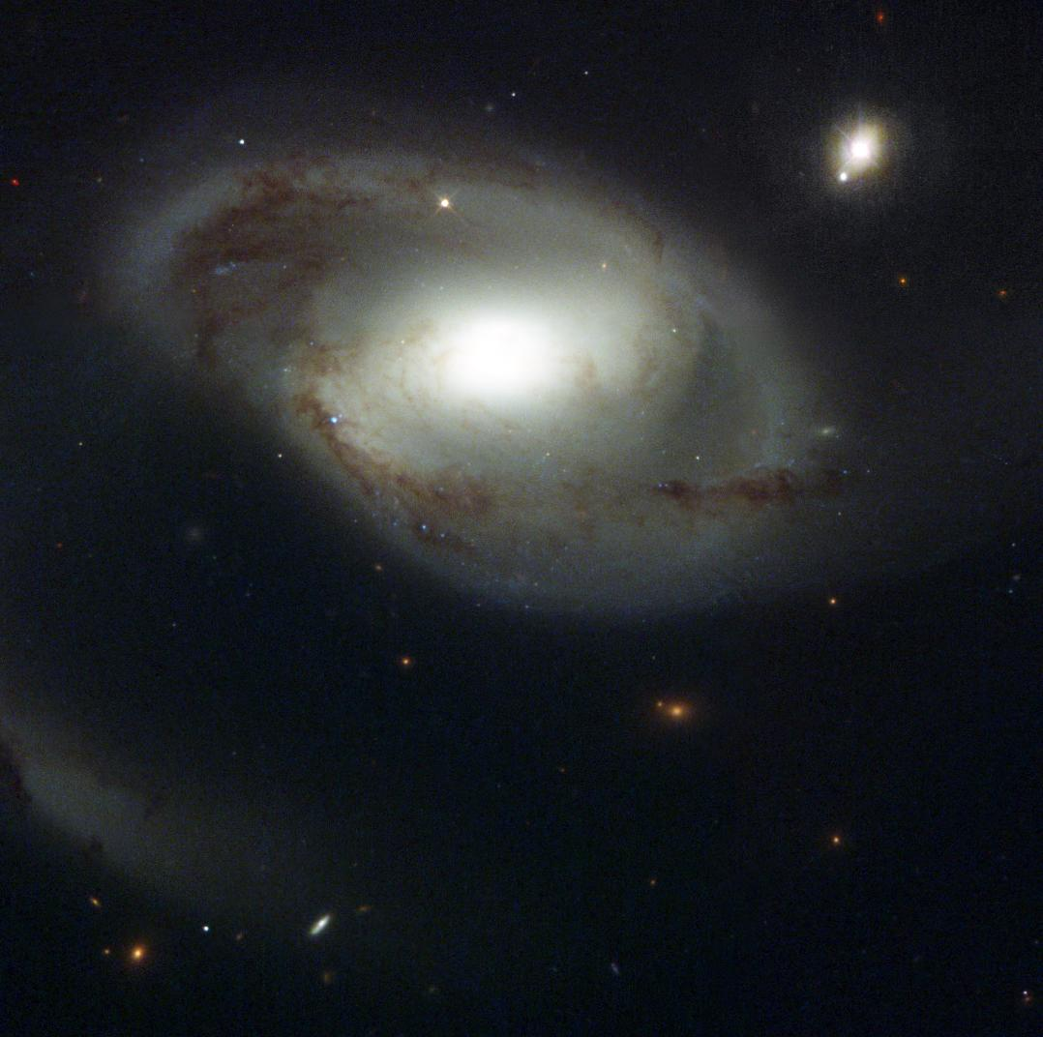
Tracing the Circumgalactic Medium with the Cosmic Origins Spectrograph
David M. French
Advisor: Bart Wakker
University of Wisconsin - Madison
April 25, 2016
Image Credit: NASA and The Hubble Heritage Team (STScI/AURA)

Slide 2
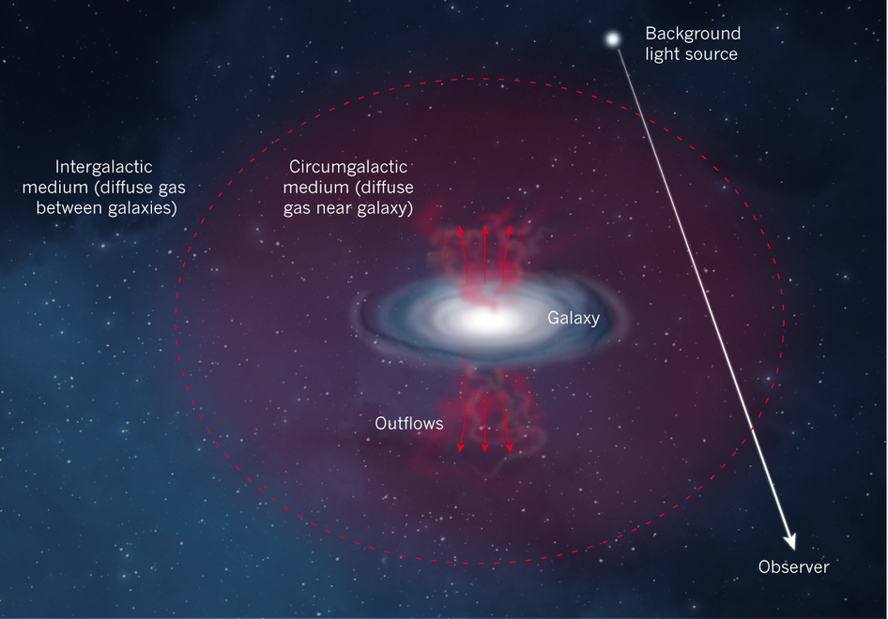
Defining the CGM
Nature 517, 444
Notes:
Put one of these first

Slide 3
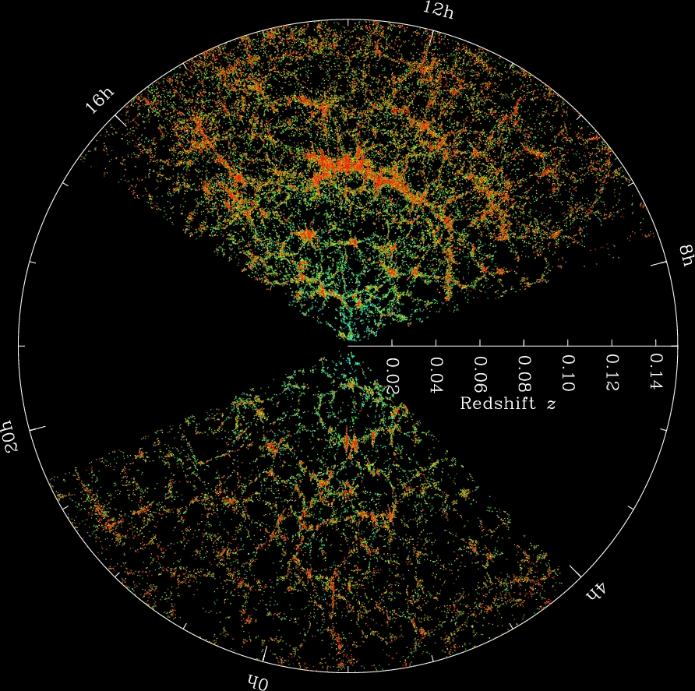
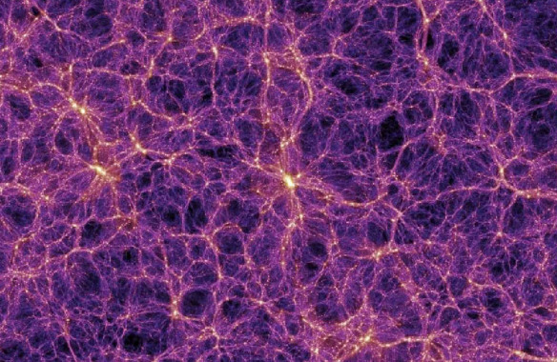
Gas in the Universe
The Millenium Simulation
SDSS Collaboration
Notes:
Gas collapsed with DM into filaments = cosmic web, formed galaxies

Slide 4
The gas nearby galaxies
Gas and galaxies both follow DM potential
Do they “know” about each other?
Notes:
Gas and galaxies both follow the DM potential, but how do the interact?

Slide 5
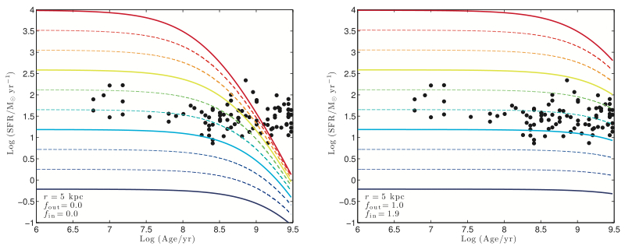
Accretion required
With no accretion
With accretion
SFR
SFR
AGE
AGE
Erb 2008
Notes:
LEFT: Closed box.
RIGHT: Outflow rate = SFR, inflow rate = 1.9*SFR

Slide 6
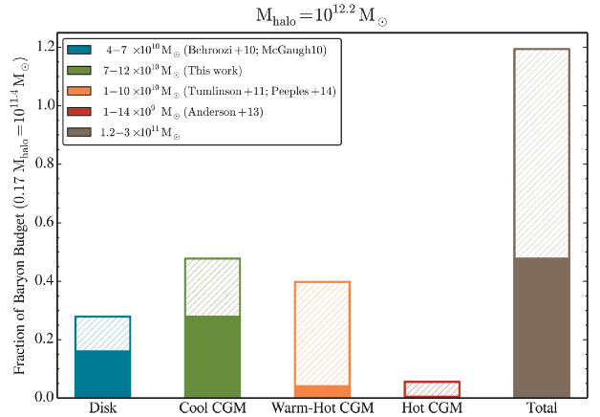
Baryon Budget
Werk et al. 2014, ApJ, 792, 128
Notes:
Green -> Lya (T = 10^4), Orange -> OVI (T = 10^5 – 10^7), Red -> X-rays (T>10^7)

Slide 7
Understanding the CGM
Galaxies need to continue accreting gas over cosmic time to match observations
Feedback kicks gas out of galaxies

Slide 8
Understanding the CGM
Galaxies need to continue accreting gas over cosmic time to match observations
Feedback kicks gas out of galaxies
How do the properties of gas correlate with associated galaxy properties?

Slide 9
Science Outline
Use archival COS sightlines (~300)
Stay close (cz < 10,000 km/s)
- Available galaxy data complete to ~0.1 L*
Automate associating galaxies – absorbers
Ask: (absorber velocity, EW, frequency)
as a function of
(Galaxy size, orientation, position)

Slide 10
Defining the CGM
ΔV
Impact parameter (ρ)
Nature 517, 444
Notes:
Put one of these first

Slide 11
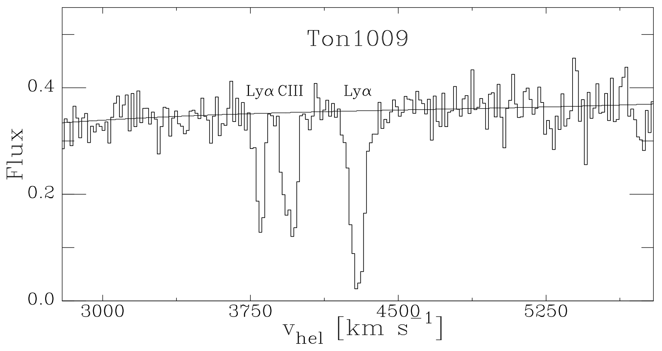
Associating galaxies with absorbers
Is this Lyα absorber associated with a galaxy?
Notes:
Define inclination and orientation

Slide 12
Associating galaxies with absorbers
Define a likelihood:
= impact parameter
= viral radius of the galaxy
Require and
Notes:
Define inclination and orientation

Slide 13
Associating galaxies with absorbers
Define a likelihood:
Notes:
Define inclination and orientation

Slide 14
Associating galaxies with absorbers
L = 0.802
L = 0.062
Notes:
Define inclination and orientation

Slide 15
Results so far…
35 COS sightlines analyzed
175 Lyα lines
- 41 associated
- 44 ambiguous (no best match)
- 88 IGM (no galaxies nearby)
Notes:
Define inclination and orientation

Slide 16
Impact parameter
Notes:
Define inclination and orientation

Slide 17
Impact parameter /
Notes:
Define inclination and orientation

Slide 18
Impact parameter vs
Notes:
Define inclination and orientation

Slide 19
Impact parameter /
Most absorbers are found around
Notes:
Absorbers are found most commonly around impact/R = 1.25

Slide 20
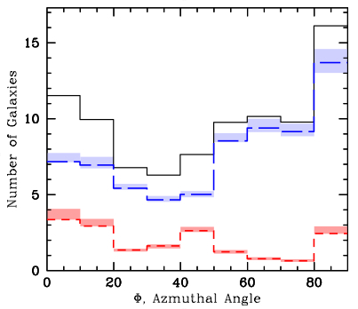
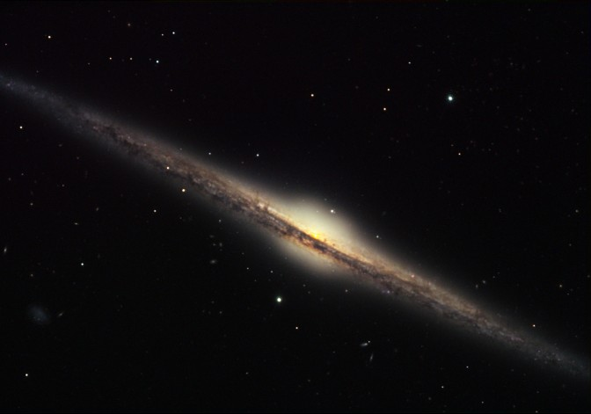
How do CGM gas properties depend on galaxy orientation?
Kacprzak et al 2012 find bimodal MgII absorption
Blue = late type
Red = early type
QSO
Major axis
Minor axis
Credit: Bruce Hugo & Leslie Gaul, Adam Block, NOAO, AURA, NSF
Kacprzak et al. 2012
Notes:
Black is total, red is red galaxies (early type), blue is blue galaxies (late type)
LABEL ON THE PLOT “MINOR” AND “MAJOR” AXIS

Slide 21
How do CGM gas properties depend on galaxy orientation?
Major vs minor?
Same for neutral gas?
QSO
Credit: Bruce Hugo & Leslie Gaul, Adam Block, NOAO, AURA, NSF
Kacprzak et al. 2012

Slide 22
How do CGM gas properties depend on galaxy orientation?
Lyα
MgII
Credit: Bruce Hugo & Leslie Gaul, Adam Block, NOAO, AURA, NSF
Kacprzak et al. 2012

Slide 23
EW vs Δv
Notes:
Median EW increases with decreasing velocity difference

Slide 24
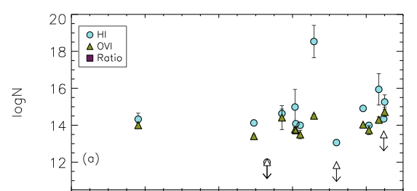

How do CGM gas properties depend on galaxy inclination?
No?
Mathes et al. 2014
Notes:
TAKE OFF THE BOTTOM PART

Slide 25
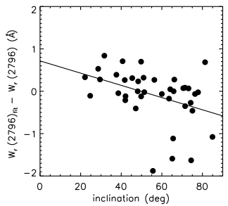
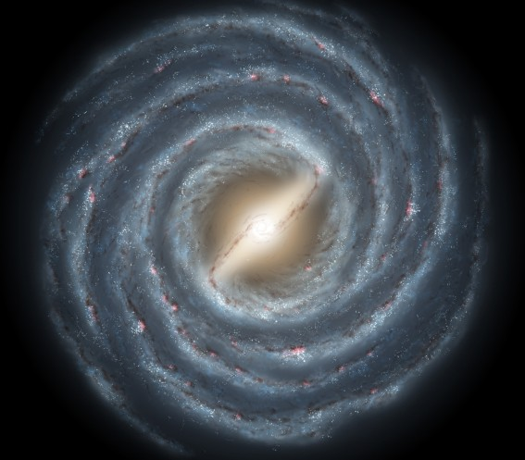
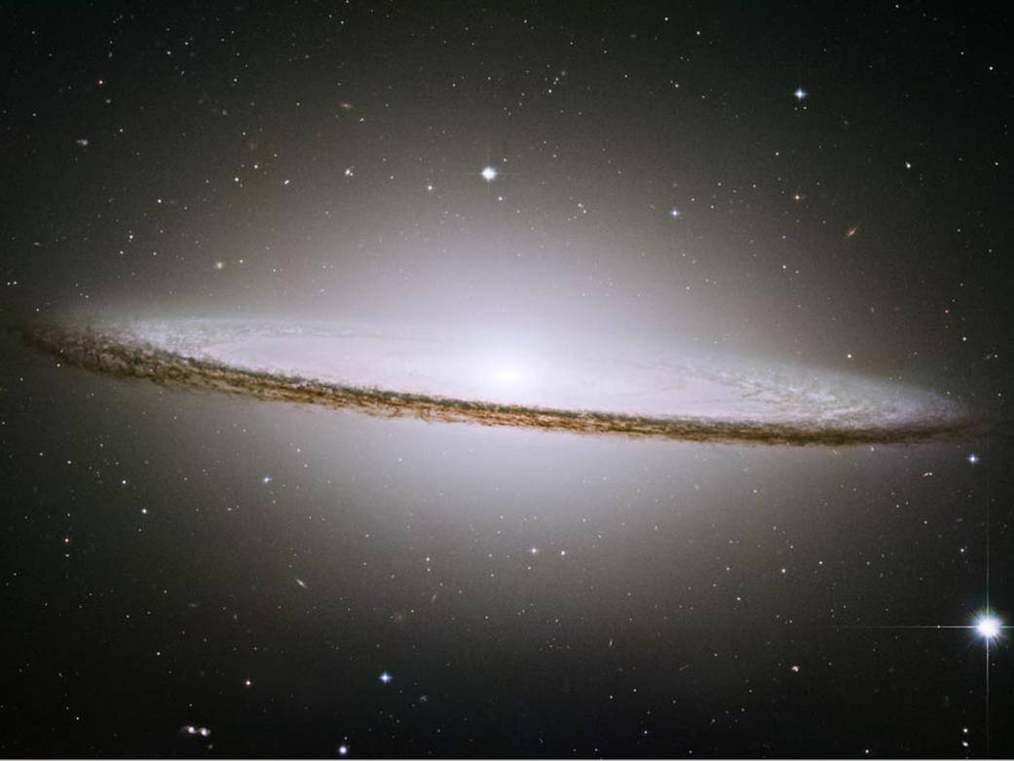
How do CGM gas properties depend on galaxy inclination?
Maybe?
MgII W (mÅ)
Kacprzak et al. 2011
Notes:
Kacprzak claims a correlation between inclination and equivalent width – halo gas has a co-planar geometry and is coupled to the disk inclination.
Y-axis: EW residuals computed from the fit between EW vs impact parameter
BLURRY

Slide 26
Galaxy Inclination
Notes:
Slight increase in median EW with increasing inclination

Slide 27
Galaxy Inclination
Notes:
Slight increase in median EW with increasing inclination

Slide 28
EW dichotomy
Notes:
Slight increase in median EW with increasing inclination

Slide 29
EW dichotomy
Median EW(blueshifted) = 343 +/- 10 mÅ
Median EW(redshifted) = 124+/- 9 mÅ
The difference: KS p-value = 0.04
Why?
- Inflows/outflows?
- Rotation?
Notes:
Slight increase in median EW with increasing inclination

Slide 30
Summary:
Define likelihood – a reproducible method for associating absorption with nearby galaxies
EW – Impact parameter anti-correlation with
Absorbers are more common near highly inclined galaxies
Absorbers most commonly found near R ~ 1.25
Azimuth dependence is unclear
Median EW increases with decreasing Δv
Redshifted absorption weaker than blueshifted?
Questions?

